Slide 1
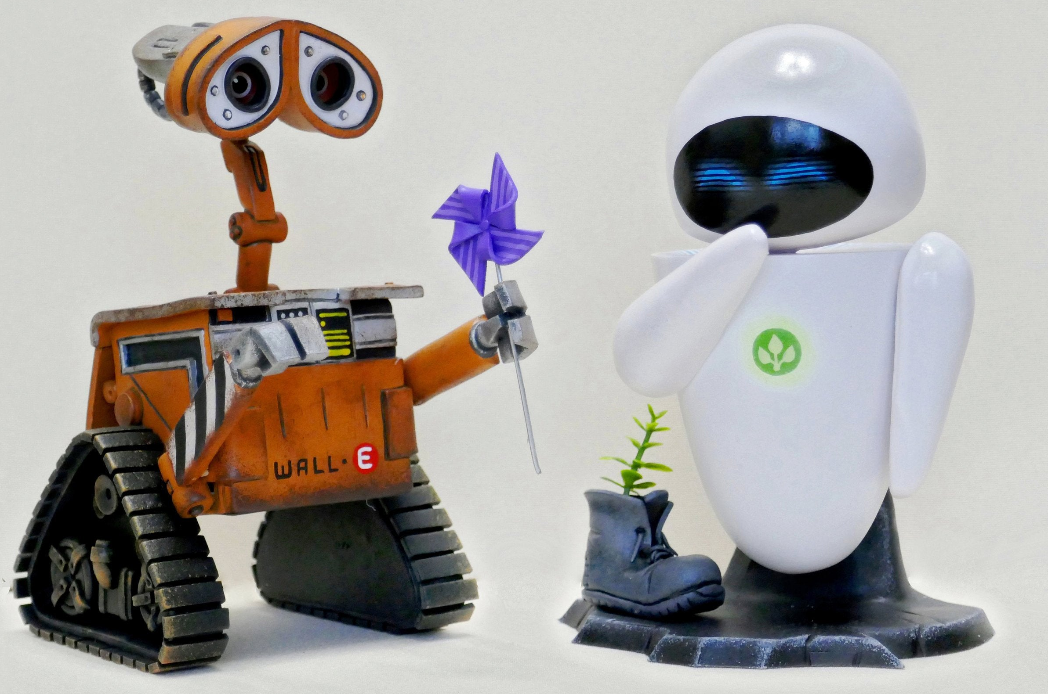
Artificial Intelligence
Dr. Piyush Joshi
IIIT Sri City

Slide 2
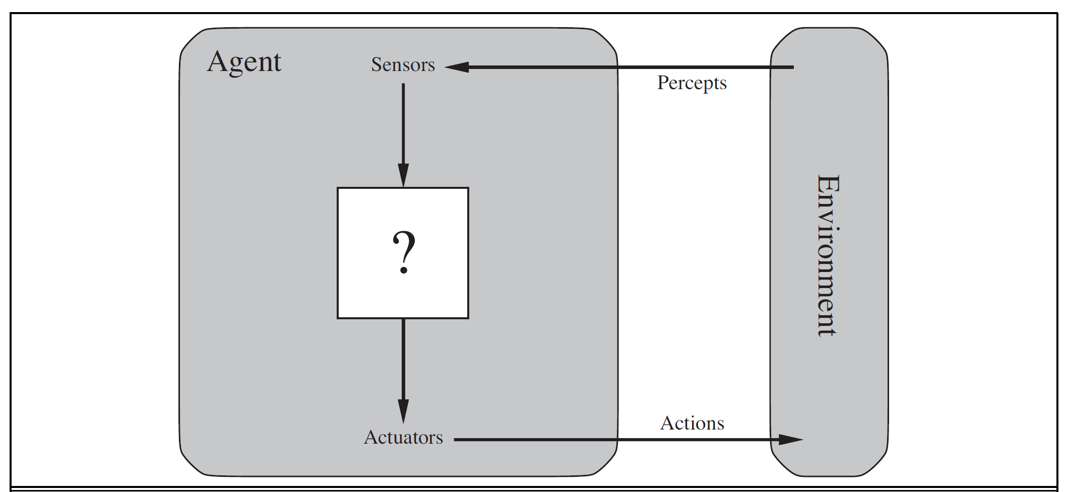
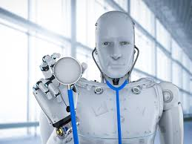
Intelligent Agent
An agent is anything that can be viewed as perceiving its environment through sensors and acting upon that environment through actuators.
An agent’s choice of action at any given instant can depend on the entire percept sequence observed to date, but not on anything it hasn’t perceived

Slide 3
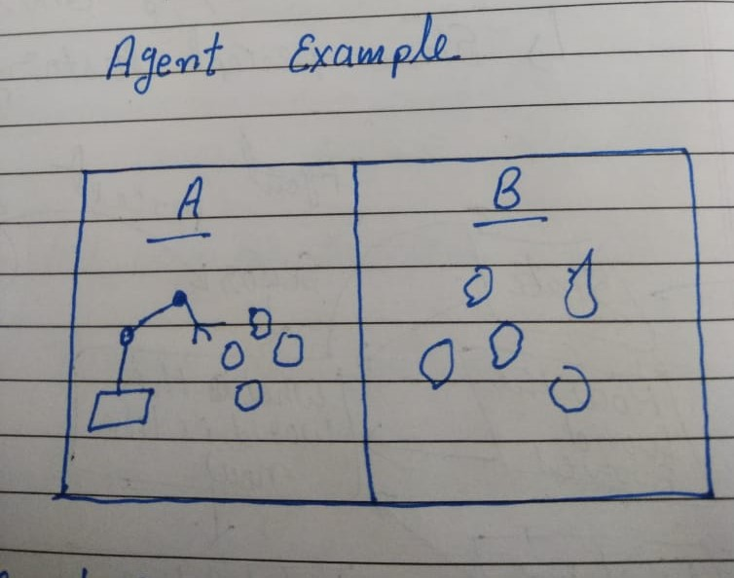
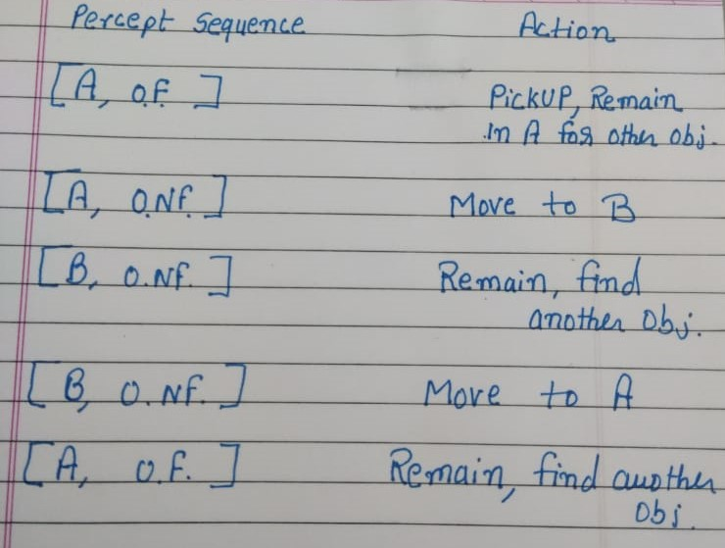
Intelligent Agent Example
OF – Object Found
O NF – Object Not Found

Slide 4
Rational Agent
A rational agent is one that does the right thing—conceptually speaking, every entry in the table for the agent function is filled out correctly.
If the sequence is desirable, then the agent has performed well. This notion of desirability is captured by a performance measure that evaluates any given sequence of environment states.
Rational at any given time depends on four things:
The performance measure that defines the criterion of success.
The agent’s prior knowledge of the environment.
The actions that the agent can perform.
The agent’s percept sequence to date.
For each possible percept sequence, a rational agent should select an action that is expected to maximize its performance measure, given the evidence provided by the percept sequence and whatever built-in knowledge the agent has.

Slide 5
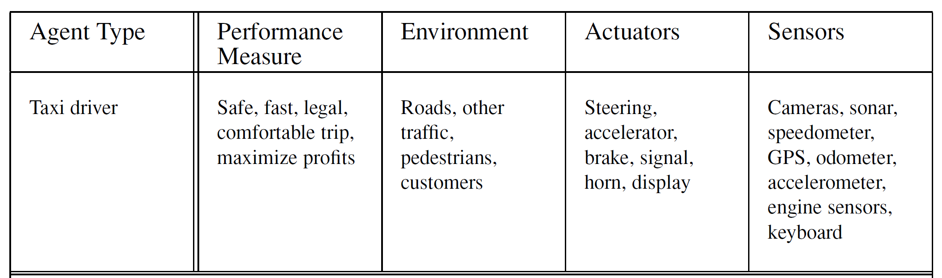
Specifying the Task Environment: PEAS Description
PEAS (Performance, Environment, Actuators, Sensors)
Make PEAS description for the Object recognition by a robot?

Slide 6
Properties of task environments
Fully observable vs. partially observable
If an agent’s sensors give it access to the complete state of the environment at each point in time.
A task environment is effectively fully observable if the sensors detect all aspects that are relevant to the choice of action.
An environment might be partially observable because of noisy and inaccurate sensors or because parts of the state are simply missing from the sensor data.

Slide 7
Properties of task environments
Single agent vs. Multiagent
An agent solving a crossword puzzle by itself is clearly in a single-agent environment.
Chess is a competitive multiagent environment.

Slide 8
Single agent vs. Multiagent
Taxi-driving environment, on the other hand, avoiding collisions maximizes the performance measure of all agents, so it is a partially cooperative multiagent environment.
It is also partially competitive because, for example, only one car can occupy a parking space.

Slide 9
Properties of task environments
Episodic vs. Sequential
In an episodic task environment, the agent’s experience is divided into atomic episodes. In each episode the agent receives a percept and then performs a single action.
An agent that has to spot defective parts on an assembly line bases each decision on the current part, regardless of previous decisions; moreover, the current decision doesn’t affect whether the next part is defective.

Slide 10
Properties of task environments
Episodic vs. Sequential
In sequential environments, on the other hand, the current decision could affect all future decisions.
Chess and taxi driving are sequential.
Short-term actions can have long-term consequences.

Slide 11
Properties of task environments
Static vs. Dynamic:
If the environment can change while an agent is deliberating, then we say the environment is dynamic for that agent; otherwise, it is static.

Slide 12
Properties of task environments
Discrete vs. continuous:
The discrete/continuous distinction applies to the state of the environment, to the way time is handled, and to the percepts and actions of the agent.
The chess environment has a finite number of distinct states.
Taxi driving is a continuous-state and continuous-time problem: the speed and location of the taxi.

Slide 13
Types of agents

Slide 14
Simple reflex agents
These agents select actions on the basis of the current percept, ignoring the rest of the percept history.
For example, the vacuum agent is a simple reflex agent, because its decision is based only on the current location and on whether that location contains dirt.

Slide 15
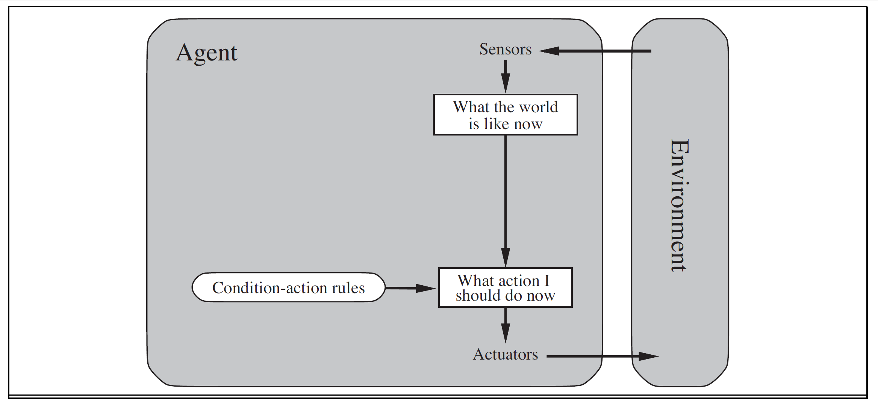
Simple reflex agents
The agent will work only if the correct decision can be made on the basis of only the current percept—that is, only if the environment is fully observable.
if car-in-front-is-braking then initiate-braking.

Slide 16
Model-based reflex agents
The most effective way to handle partial observability is for the agent to keep track of the part of the world it can’t see now.
That is, the agent should maintain some sort of internal state that depends on the percept history.

Slide 17
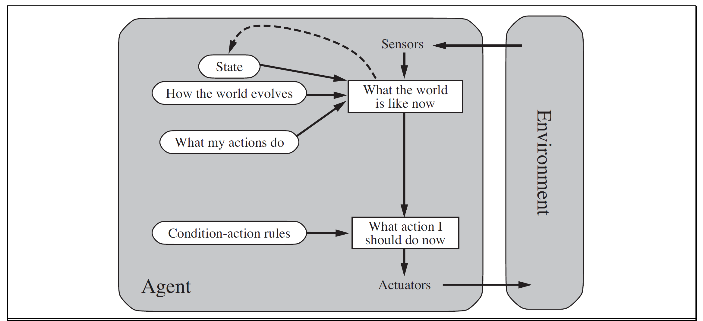
Model-based reflex agents
Updating this internal state information as time goes by requires two kinds of knowledge to be encoded in the agent.
We need some information about how the world evolves independently of the agent. (overtaking car now closer than a moment ago)
We need some information about how the agent’s own actions affect the world. (the agent turns the steering wheel clockwise, the car turns to the right)

Slide 18
Model-based reflex agents
Regardless of the kind of representation used, it is seldom possible for the agent to determine the current state of a partially observable environment exactly.
Instead, the box labeled “what the world is like now” represents the agent’s “best guess” (or sometimes best guesses).
For example, an automated taxi may not be able to see around the large truck that has stopped in front of it and can only guess about what may be causing the hold-up. Thus, uncertainty about the current state may be unavoidable, but the agent still has to make a decision.

Slide 19
Goal-based agents
Knowing something about the current state of the environment is not always enough to decide what to do.
For example, at a road junction, the taxi can turn left, turn right, or go straight on. The correct decision depends on where the taxi is trying to get to.

Slide 20
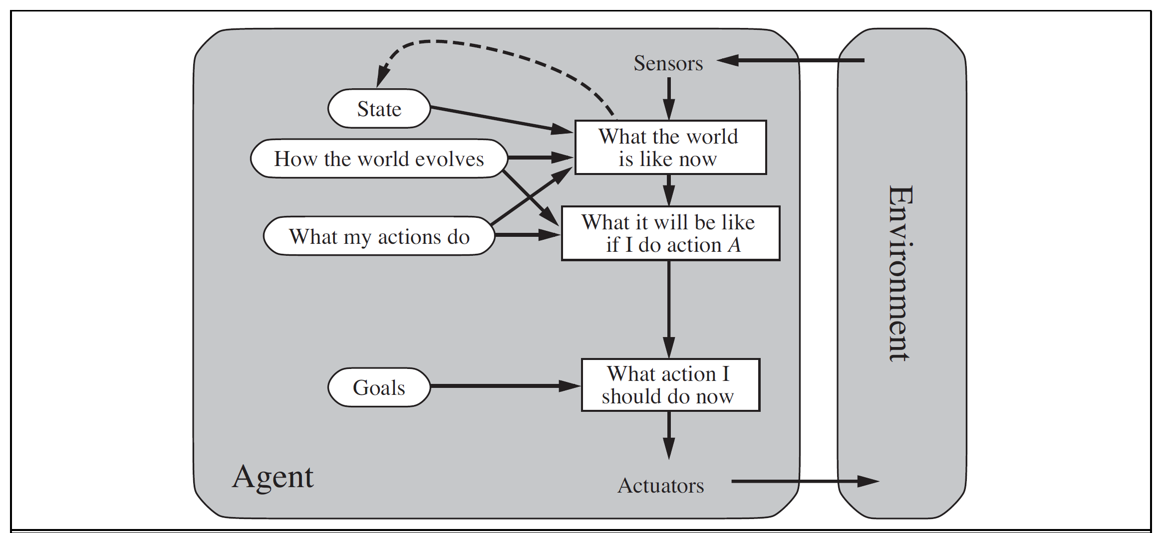
Goal-based agents
In other words, as well as a current state description, the agent needs some sort of goal information that describes situations that are desirable.
Agent keeps track of the world state as well as a set of goals it is trying to achieve, and chooses an action that will (eventually) lead to the achievement of its goals.

Slide 21
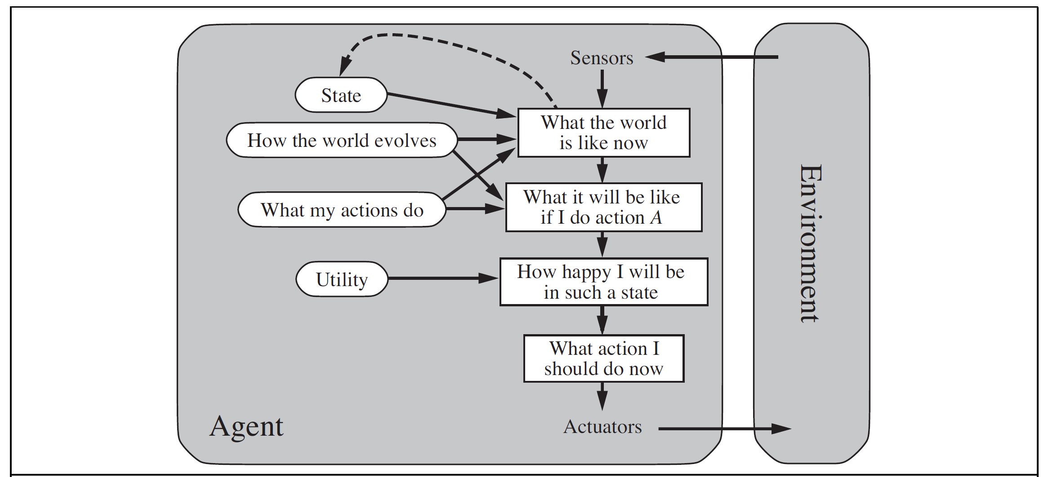
Utility-based agents
A model-based, utility-based agent. It uses a model of the world, along with a utility function that measures its preferences among states of the world.

